Slide 1



Objectives
  In this session, you will learn to:
    Work with output stream
    Get familiar with NIO

Slide 2

Working with Output Stream
  Scenario:
Needs to develop a Banking application.
A developer needs to implement a set of functionality to maintain a log for every transaction performed in the application.
A developer

Slide 3
Working with Output Stream (Contd.)
  Scenario (Contd.):
For this, you need to write the data to an output stream, such as a file.
To write the data in the form of characters, Java provides the Writer classes inside the java.io package.

Slide 4
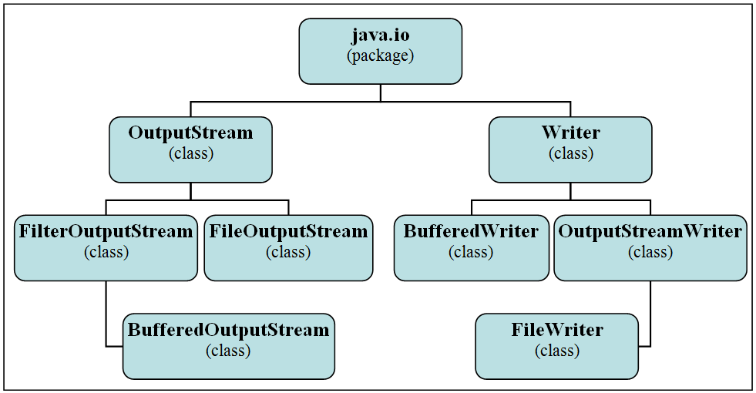
Working with Output Stream (Contd.)
  The following figure shows the class hierarchy of the java.io package.

Slide 5
Using the FileOutputStream Class
  The FileOutputStream class is used for writing data, byte by byte, to a file.
  Some of the constructors of the FileOutputStream class are:
    FileOutputStream(File file, boolean append)
    FileOutputStream(FileDescriptor fdObj)
    FileOutputStream(String name)
    FileOutputStream(String name, boolean append)
  Some of the methods of the FileOutputStream class are:
    FileDescriptor getFD()
    void write(int b)
  Consider the code given in the embedded document to write the data to a file using the FileOutputStream class:

Slide 6
Using the BufferedOutputStream Class
  The BufferedOutputStream class writes bytes to an output stream using a buffer for increased efficiency.
  Some of the constructors of the BufferedOutputStream class are:
    BufferedOutputStream(OutputStream out)
    BufferedOutputStream(Outputstream out, int size)
  Some of the methods of the BufferedOutputStream class are:
    void flush()
    void write(byte[] b, int off, int len)
  Consider the code given in the embedded document that prints the output on the console:

Slide 7
Using the BufferedWriter Class
  The BufferedWriter class can be used to write text to an output stream.
  This class writes relatively large chunks of data to an output stream at once.
  Some of the constructors of the BufferedWriter class are:
    BufferedWriter(Writer out)
    BufferedWriter(Writer out, int size)
  Some of the methods of the BufferedWriter class are:
    void newLine()
    void write(char[] cbuf, int off, int len)
  Consider the code given in the embedded document to write the data to the console using the BufferedWriter class:

Slide 8
Using the FileWriter Class
  The FileWriter class:
    Writes character data to a file.
    Does not define any methods of its own.
  The FileWriter class derives all methods from its base classes, such as the Writer and the OutputStreamWriter classes.
  Some of the constructors of the FileWriter class are:
    FileWriter(File file)
    FileWriter(File file,boolean append)
    FileWriter(FileDescriptor fd)
    FileWriter(String fileName,boolean append)
  Consider the code given in the embedded document that writes the data to the file:

Slide 9
Just a minute
  Which one of the following FileWriter constructors will you use if there is a requirement to append data at the end of a new file?
    FileWriter(File file)
    FileWriter(File file,boolean append)
    FileWriter(FileDescriptor fd)
    FileWriter(String fileName,boolean append)

Slide 10
Just a minute (Contd.)
  Solution:
    FileWriter(String fileName,boolean append)

